Slide 1
Going Beyond Blog Formatting
</>
<ashley> <hazel> <stephanie>
Notes:
Ashley

Slide 2

About Ashley
#Ashley {
age: 24;
blog: url(‘http://www.nosegraze.com’);
known-for: ‘Ultimate Book Blogger Plugin’;
occupation: self-employed;
platform: WordPress;
skills: Designer, Coder, Blogger;
}
NOSE GRAZE
Notes:
Ashley

Slide 3

About Hazel
#Hazel {
age: 19;
country: Philippines;
blog: url(‘http://staybookish.net’);
occupation: student;
platform: WordPress;
skills: Blogger, Designer, Photographer;
}
STAY BOOKISH
Notes:
Hazel

Slide 4

About Stephanie
#Stephanie {
age: 21;
blog: url(‘http://www.thesepaperhearts.com’);
known-for: Blogger Tutorials;
occupation: Developer;
platform: WordPress;
skills: Designer, Coder, Blogger;
}
THESE PAPER HEARTS
Notes:
Stephanie

Slide 5
Intro to HTML and CSS
Learn what the difference is and how to recognize them.
Notes:
Hazel

Slide 6
Basis of Blog Formatting
HTML
  Hypertext Markup Language
  skeleton that gives every webpage structure
  made up of elements
  enclose content
CSS
  Cascading Style Sheets
  describing the presentation or display of HTML
  including colors, layout, and fonts
  enhances visual design
Notes:
Hazel

Slide 7

HTML
House Structure: Walls, roof, floors, doors
HTML Structure: head, body, footer
Notes:
Hazel

Slide 8
HTML
This is an HTML code:
<a href="http://goodreads.com">Goodreads</a>
Notes:
Hazel

Slide 9

CSS
Interior Decor: Paint, furnishings, accessories
CSS Design: font, color, size
Notes:
Hazel

Slide 10
CSS
This is a CSS code:
h1 {color: #666666;}
Notes:
Hazel

Slide 11
Digging into HTML and CSS
Let’s get messy with some tags!
Notes:
Ashley

Slide 12
Identifying HTML Tags
You can recognize HTML tags by their angle brackets.
These brackets are used to signify the beginning of a tag and the end of a tag.
Example:
The text you want inside.
<strong>This is bolded text.</strong>
Signifies the start of the tag.
Signifies the end of the tag.
This is bolded text.
Notes:
Ashley

Slide 13
Kinds of HTML tags
Hundreds of different HTML tags.
Some tags do specific things automatically.
  <strong> makes text bold automatically
  <a href=“link url”>Text</a> creates a link automatically
Others don’t do anything special without CSS.
  <div> and <section> have no different appearance without CSS.
Notes:
Ashley

Slide 14
Kinds of HTML tags
Paragraphs ( <p> )
Bolded text ( <strong> )
Italicized text ( <em> )
Links ( <a href=“link here”>My linked text</a> )
Images ( <img src=“image URL here” alt=“Description”> )
Sections ( <section> or <div> )
Notes:
Ashley

Slide 15
Making tags more specific
Without classes and IDs, you have no way to identify just one specific tag in CSS.
Imagine you’re in a room full of people…
Notes:
Ashley
Room full of people:
People (person tag)
Tables (table tag)
Chairs (chair tag)
“Hey everyone” – everyone looks at me because I’m just addressing all the <people> tags
Add classes to be more specific
“Brunette” class – all brunettes
“Girl” tag – all girls
Classes – multiple people
Tags – one person
Name – hey “Ashley”

Slide 16
How to apply classes and IDs
Classes are used to link multiple tags together under a common identifier. So you can have many objects on a page with the same class name.
  Tag with a class name:
  <div class=“blue-box”>Text here</div>
IDs are to target one tag, and one tag only. You shouldn’t use the same ID name twice on a page!
  Tag with an ID:
  <div id=“contact-me”>Contact info here</div>
Notes:
Ashley

Slide 17
So how do we use CSS?
The structure of CSS looks like this:
tag {
property: value;
}
div {
color: black;
}
Notes:
Ashley

Slide 18
Using classes and IDs in CSS
Period before class name
.classname {
background: grey;
}
Hash before ID name
#idname {
background: grey;
}
Notes:
Ashley

Slide 19
Going back to that person example…
See how a person’s traits could be used in CSS
#Ashley {
eye-color: green;
skin-tone: pale;
occupation: “Web Developer”;
}
A real CSS example you might use on a blog
.blog-post {
background: green;
color: black;
font-family: Arial, sans-serif;
font-weight: bold;
}
Notes:
Ashley

Slide 20
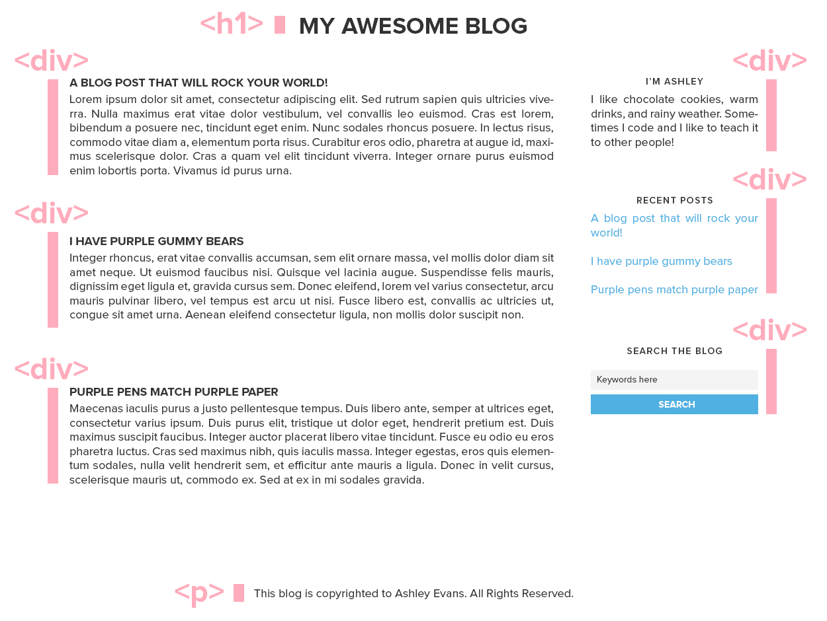
Notes:
Ashley

Slide 21
Applying CSS to a tag
div {
background: #f4f4f4;
}
Notes:
Ashley

Slide 22
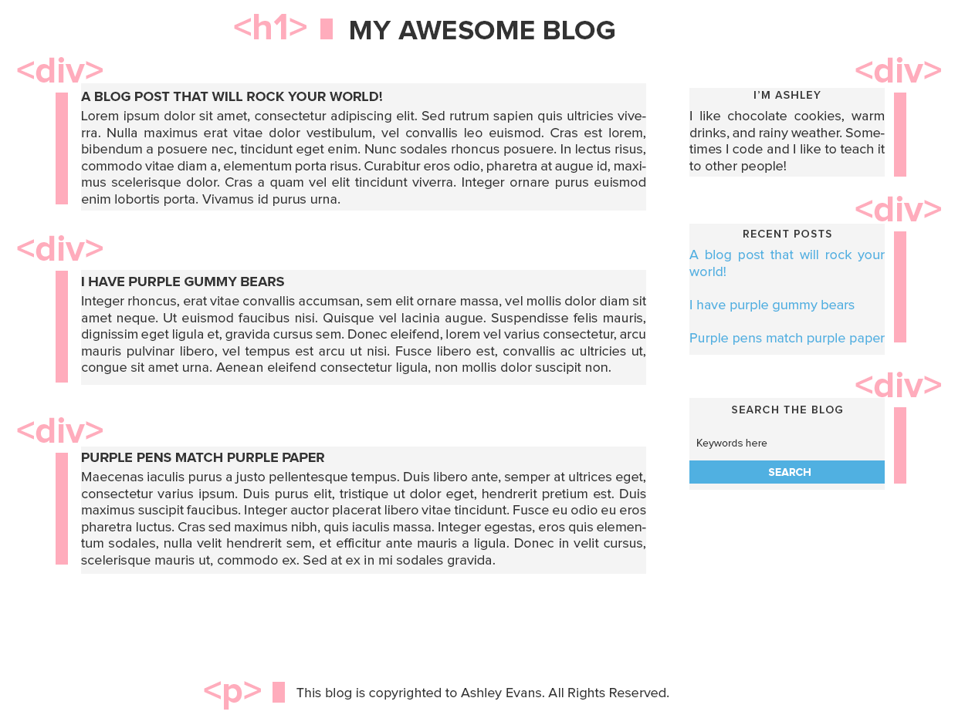
Notes:
Ashley

Slide 23
Let’s only target the sidebar widgets
First we have to give the widgets a class name. There are multiple widgets which is why we use a class instead of an ID.
Let’s change our CSS to target only this class:
.widget {
background: #f4f4f4;
}
<div>
<div class=“widget”>
Notes:
Ashley

Slide 24
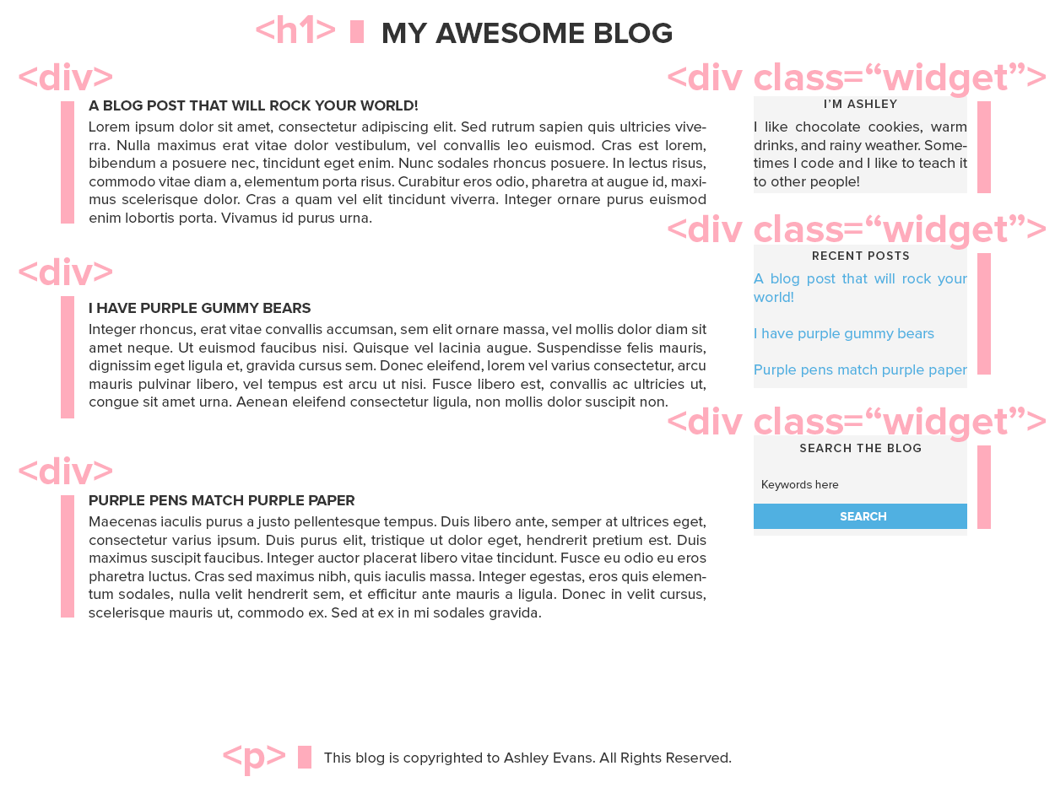
Notes:
Ashley

Slide 25
Nesting in CSS
What happens when you have one HTML tag inside another.
Notes:
Stephanie

Slide 26
CSS Nesting
Allows you to:
Assign CSS to HTML that does not have an ID or class.
Use fewer IDs and classes.
  Cleaner HTML
  Easier to make CSS changes
Access multiple HTML tags at once
Be more exact in targeting HTML tags
Notes:
Stephanie

Slide 27
CSS Nesting – Parent/Child
class=‘post’
h3
text
text
text
h3
h3
text
class=‘widget’
h3
text
h3
text
Notes:
Stephanie
Briefly explain technical term of parent/child. Shows a visual representation. Analogy of a container full of items – compare to HTML tags containing other HTML tags. When you have two container boxes with an similar object in each, how do you tell the two apart?

Slide 28
CSS Nesting – Code Example
<div class=“post”>
<h3>This is my heading</h3>
<p>This is the text inside the post class.</p>
</div>
<div class=“widget”>
<h3>Widget Heading</h3>
<p>Widget text.</p>
</div>
Notes:
Stephanie
Code representation of the previous slide.

Slide 29
CSS Nesting – Apply CSS
Change h3 tag to red.
h3 {
color: red;
}
Change h3 tag inside post class to red.
.post h3 {
color: red;
}
Notes:
Stephanie
Discuss how you would then add css to differentiate between the widget h3/posts h3/and all h3 tags.

Slide 30
Live HTML/CSS Examples
We’ll show you exactly how this works!
Notes:
Stephanie
What to cover:
-change link colors
-change post heading link colors
-change footer link color
-add grey background to widgets
-add spacing between posts
-add background color to heading area

Slide 31
Where to put CSS
There’s a special place to put CSS on your blog.
Notes:
Hazel

Slide 32
Blogger
Template Designer
HTML Template Editor
Notes:
Hazel

Slide 33
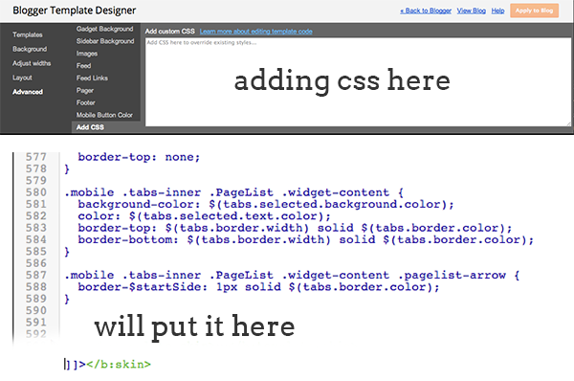
Add CSS in Template Designer
Notes:
Hazel

Slide 34
Add CSS in HTML Template Editor
Notes:
Hazel

Slide 35
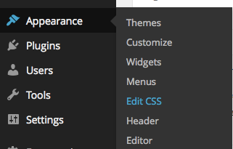
Wordpress (Self-Hosted)
Install custom CSS plugins:
Jetpack
Simple Custom CSS
Notes:
Hazel

Slide 36
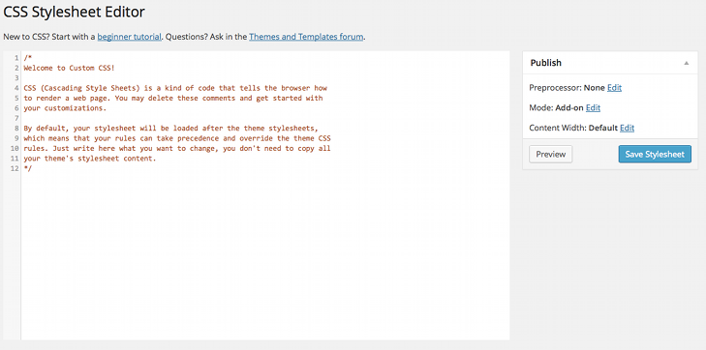
Jetpack Custom CSS
Notes:
Hazel

Slide 37
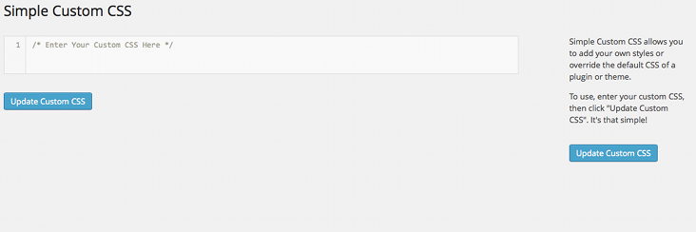
Simple Custom CSS
Notes:
Hazel

Slide 38
Inspect Element
To help you figure out what CSS classes and IDs you need.
Notes:
Stephanie

Slide 39
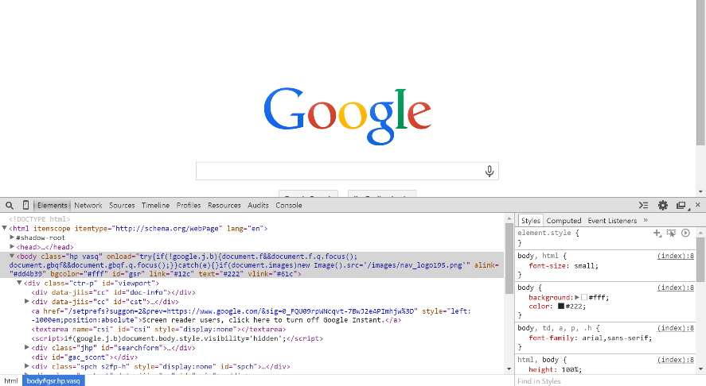
Using the Inspect Element Tool
Notes:
Stephanie
THE BEST THING EVER!

Slide 40
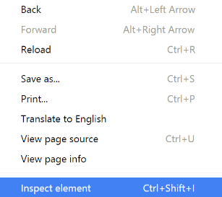
Inspect Element
The inspect element tool allows you to view the HTML and CSS of any web page and make temporary changes.
Access it by:
  Pressing the F12 key on your keyboard.
  Right clicking on a website element and
  selecting: Inspect Element.
Notes:
Stephanie
Temporary changes – only you can see the changes and when you refresh the page, they go away.
A quick way to find classes and ids of HTML elements that you can’t find in your template files.
Use inspect element on tutorialexample.html file
Topics to cover:
-customize read more link
-find post heading and change font
-customize subscription widget
-customize cloud tags

Slide 41
Real world examples
CSS snippets you might use on your actual blog!
Notes:
Hazel

Slide 42
Background
body{
  background-color: #FCF9F8;
  background-image: url(‘http://www.yourblog.com/imagefilename.png’)
  background-repeat: repeat;
  background-position: top right;
  }
body {
  background: #FCF9F8 url(‘http://www.yourblog.com/imagefilename.png’) repeat top right;
  }
Notes:
Hazel

Slide 43
Add spacing between elements
Margin
  Adds spacing outside of the background area.
  .mybox {
  margin: 10px;
  }
Padding
  Adds spacing inside of the background area.
  .mybox {
  padding: 10px;
  }
Notes:
Ashley

Slide 44
Margin vs Padding
Margin
Padding
This is my text inside here! Isn’t is looovely.
This is my text inside
here! Isn’t is looovely.
Notes:
Ashley

Slide 45
Links: Posts, Sidebar, Navigation, Read More
a:link {
  color: #fff;
  background: none;
  border: 1px solid #000;
  letter-spacing: 1px;
  font-style: italic;
  font-weight: normal;
  text-decoration: line-through;
  }
a:visited {}
a:hover {}
Notes:
Hazel

Slide 46
Lists
ul {
  list-style-type: circle;
  list-style-image: url(filename.jpg);
  }
Notes:
Hazel

Slide 47
Buttons: Submit, Subscribe
.button {
  background: #FFDAB9;
  font-family: 'Alegreya';
  font-size:16px;
  color: #656060;
  text-transform: uppercase;
  width: 100%;
  height: auto;
  border-radius: 20px;
  -moz-border-radius: 20px;
  -webkit-border-radius: 20px;
  }
.button:hover {
  background: #FFBB7F;
  font-family: 'Alegreya';
  font-size:16px;
  color: #656060;
  text-transform: uppercase;
  width: 100%;
  height: auto;
  border-radius: 20px;
  -moz-border-radius: 20px;
  -webkit-border-radius: 20px;
  }
CLICK
CLICK
Notes:
Hazel

Slide 48
Make two sections sit side by side.
Section #1
Morbi id turpis iaculis, ullamcorper arcu at, laoreet metus. Sed facilisis leo vitae quam tempus porta. Curabitur commodo leo tempor luctus accumsan. Morbi fermentum pharetra libero, nec lacinia sapien ultrices vel. Praesent pellentesque pulvinar nisl id elementum.
Section #2
Sed vel elementum felis. Nullam scelerisque augue et sem faucibus, ac ornare ligula viverra. Cras vestibulum lobortis erat ac dapibus. Cras eleifend dui a tellus rutrum tempus. Vestibulum rutrum massa sit amet hendrerit scelerisque. Nam ligula sapien, mollis quis sem et, porttitor eleifend ipsum.

Slide 49
Make two sections sit side by side – The HTML
<div class=“row”>
<div class=“half”>
<p><strong>Section #1</strong></p>
<p>The text for section #1 goes here.</p>
</div>
<div class=“half”>
… (repeat from section #1)
</div>
</div>

Slide 50
The CSS!
.row {
clear: both;
overflow: hidden;
}
.half {
float: left;
width: 50%;
}

Slide 51
That’s it for now!
Go forth and become a coding master.

