Slide 1
Optimizing Your WordPress Blog
Ashley, Brittany, Cialina, Rhys

Slide 2

Ashley
Nose Graze ( nosegraze.com )
Blogging tips, coding tutorials
Self employed
Coder, blogger, WordPress guru
Ultimate Book Blogger Plugin

Slide 3

Brittany
BookBumblings.com
Blogging tips & challenges, reviews
Marketing & PR manager
Freelance writer & marketer
BookBlogWriMo challenge
Be a Better Blogger challenge

Slide 4

Cialina
Muggle-Born.net
Book reviews (YA & Romance)
Self-taught coder, long-time blogger
Previous NYC museum employee
Now in the Digital Dept. in Publishing

Slide 5

Rhys
ThirstForFiction (thirstforfiction.com)
Blogging tips, coding tutorials
Gap year / student
Coder, blogger, WordPress enthusiast
Theatre luvvie (I produce)

Slide 6
How to expand your blog’s reach
Brittany // Get more followers!

Slide 7
The Keys to Long-Term Growth
Consistent traffic
Social shares

Slide 8
The Keys to Long-Term Growth
Consistent traffic = SEO
Social shares = shareability

Slide 9
Search Engine Optimization (SEO)
Brittany // More traffic through search engines!

Slide 10
How to Improve On-Page SEO: WordPress SEO by Yoast
Write naturally
Use keywords in different aspects of the post (title, URL, alt tags, etc.)
Use semantic (related keywords) to add context
Other benefits: analysis, keeping track of focus keywords, meta descriptions

Slide 11
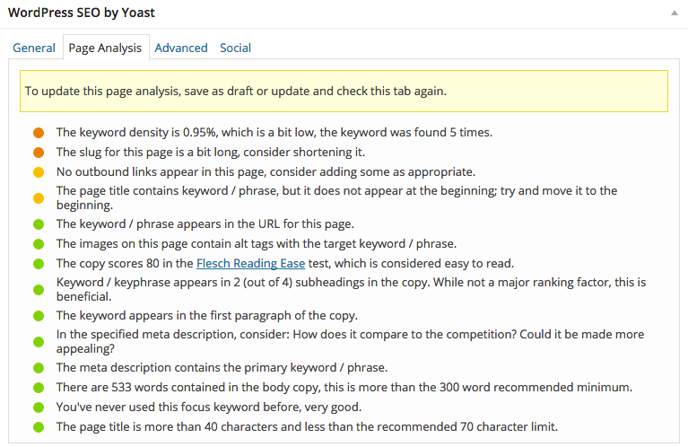

Slide 12
How to keep people on your site: Related Posts
Add links to other related pages of your blog
Reduces bounce rate and increases pages per visit

Slide 13


Slide 14
Shareability
Brittany // Get people to share your posts!

Slide 15
Never share a blog post just once
Keeps social referral traffic up
Shares old posts to new audience members
Fills your social editorial calendar

Slide 16
New post sharing schedule:
Buffer app’s Power Scheduler
CoSchedule’s sharing panel in WordPress (paid)

Slide 17
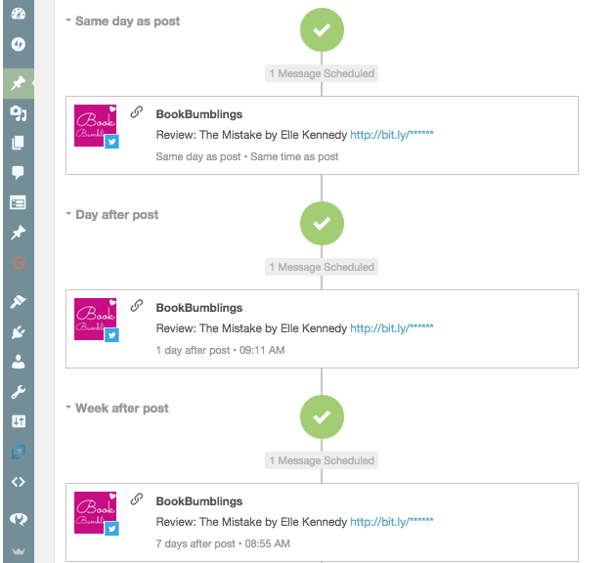

Slide 18
Automate sharing older posts
Revive Old Posts plugin
MeetEdgar (paid)
Spreadsheet + Buffer/Hootsuite/etc. bulk upload

Slide 19
Encourage social shares
ClickToTweet by TodayMade – use “click to tweets/shares” to encourage sharing
Make sure share buttons are easy to find
SumoMe – Consider using share/“Pin it!” buttons on images

Slide 20
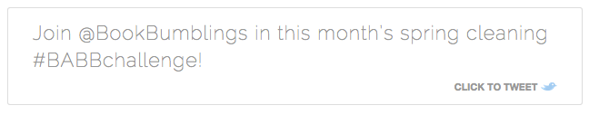


Slide 21
Speeding up your book blog
Rhys // Let’s make it super fast!
Notes:
Rhys

Slide 22
Why is it important?
Google uses site speed as a factor in its Page Rank algorithm.
Mobile internet is (generally) slower than home wifi.
Research shows 75% of users leave a page that hasn’t loaded in under 4 seconds.
51% of online shoppers in the US would not complete a purchase if the site is “too slow”.
At the end of the day, fast page-load times can only be a good thing.
Notes:
There are few reasons why the load times of your blog are important.
For one, google actually takes it into account when displaying you in google results; particularly in mobile search, google is trying to encourage faster load times. Nobody wants to wait 10 seconds for a page to load on dodgy 3G signal while out and about. In fact, google actually recommends mobile site speeds of under 1 second – and that’s quite an ask.
According to research, 75% of users leave a page if it hasn’t loaded in 4 seconds. http://www.aykira.com.au/2014/04/importance-website-loading-speed-top-3-factors-limit-website-speed/
Fast page load times can only be a good thing. Nobody is gonna leave your site because it’s too fast!

Slide 23
How can we improve?
Better hosting
  Expensive
Content Delivery Networks
Site Caching
Removing bloated content
Notes:
So what are the solutions?
Your first thought might be – better hosting. And this is true; a faster host WILL speed up your blog. But the problem is that better hosting can often be quite costly, and most of us aren’t exactly swimming in cash.
What you might not know is that there are several great FREE solutions to improve your blog. These include:
Content Deliverry Networks or CDNs
Site Caching
Removing bloated content and plugins
I’m going to show you how to use these three things to improve your page loads by a considerable amount.

Slide 24
Content Delivery Networks
Normally, site is hosted in a single location
Users far from this location are forced to wait longer for their page to load than those living closer to the server
CDNs are multiple servers around the globe all mirroring the original server
Browsers can get most of their content from their nearest CDN server
Page speeds are faster for the vast majority of users
Notes:
The problem with a normal server is that it’s located in one place: somewhere in the world there’s a computer with all your site files on. Let’s say it’s in LA. That’s alright for the residents of California; they’re quite close to the server, so data packages and requests don’t have to travel as far to get to their computer. But if you live in NYC or worse still, London, all your website stuff has to travel across half the world to reach it’s readers. And that takes time.
The solution is a content delivery network – a network of servers across the globe that all have your important (static) files such as image files and stylesheets. This means that the data requests only have to travel as far as the nearest server – so if there’s a server in Dublin, Ireland, then as a Londoner, you’re in luck; you don’t’ have to wait as long a you used to for all the data to travel your way.
I’m going to show you how to set up a CDN for your blog with Cloudflare. They have a free option and are pretty easy to use.

Slide 25
CNDs: CloudFlare
According to CloudFlare, your site will:
  Loads 2x faster
  Use 60% less bandwidth
  Have 65% fewer requests
  Be way more secure
My own book blog, ThirstForFiction lost a couple of seconds of load time – and that can mean a lot.

Slide 26
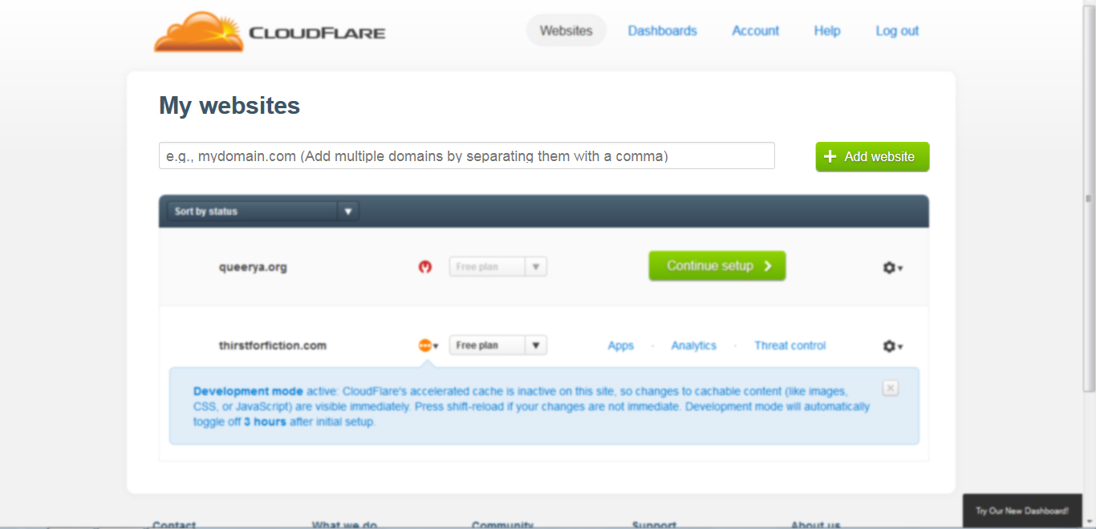
Notes:
Step 1: enter your domain name and click “add website”

Slide 27
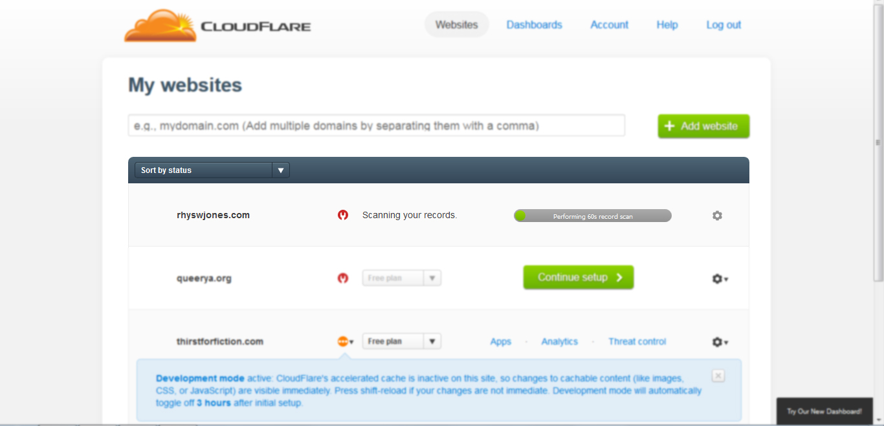
Notes:
Step 2: Cloudflare takes about a minute to scan your DNS records/site

Slide 28
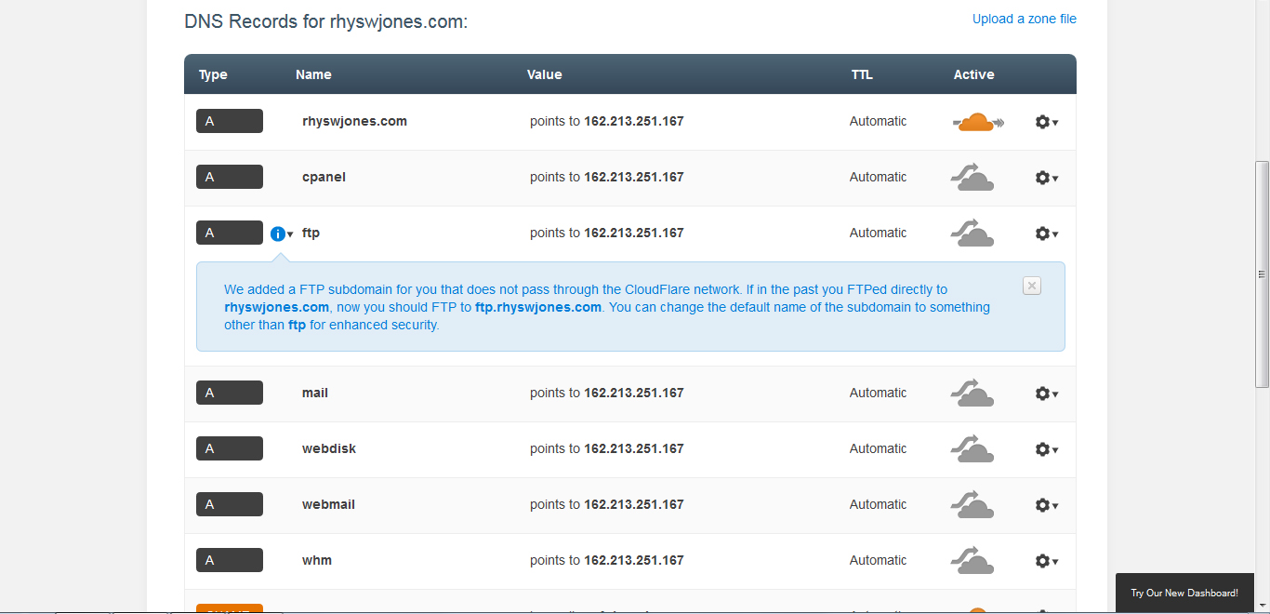
Notes:
Step 3: select records you want to have on Cloudflare. Normally, the default settings are perfect – you can see here that the domain rhyswjones.com is ‘active’. Unless you have specific subdomains or subsites, just go with what they provide.
If you know you have extra DNS records, you can add them here.

Slide 29
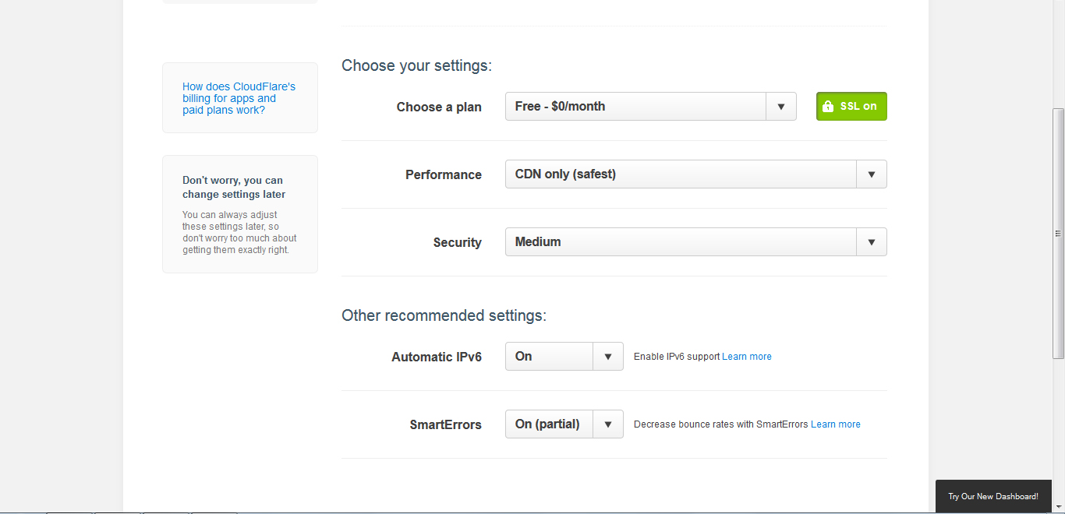
Notes:
Step 4: choose your settings. Make sure you select the free option – it’ll try and make you purchase one – and then use the default settings.

Slide 30
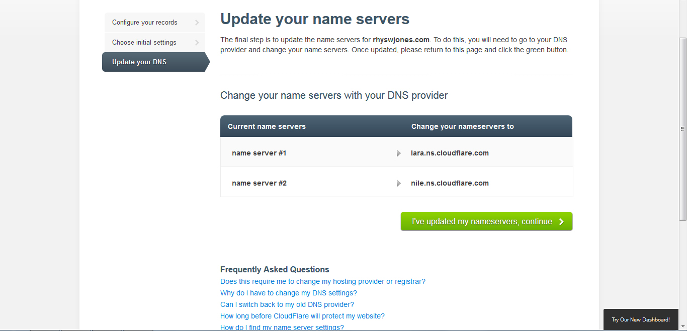
Notes:
The last step is to change your nameservers with your domain name company. It’s quite easy and if you’re not sure how to do this with your company, you should be able to find a tutorial with them or use their support.

Slide 31
Voila! Faster site!
Once that’s all done, it can take up to 24 hours for everything to take effect. And voila! Your site should be a lot faster.
But there’s still more we can do…
Notes:
Once that’s all done, it can take up to 24 hours for everything to take effect. And voila! Your site should be a lot faster.

Slide 32
W3 Total Cache
Arguably the best WordPress caching plugin
Caching means that common server requests (ie. For an image) are stored in an easy-accessible place
That means that those files can be retrieved faster
Decreases page load time
Loads of options
Google “recommended settings w3 total cache” for comprehensive details about how to set up the plugin.

Slide 33
P3 Plugin Performance Profiler
Nifty little plugin that measures how much each plugin adds to a page load
Once installed, just start a scan

Slide 34
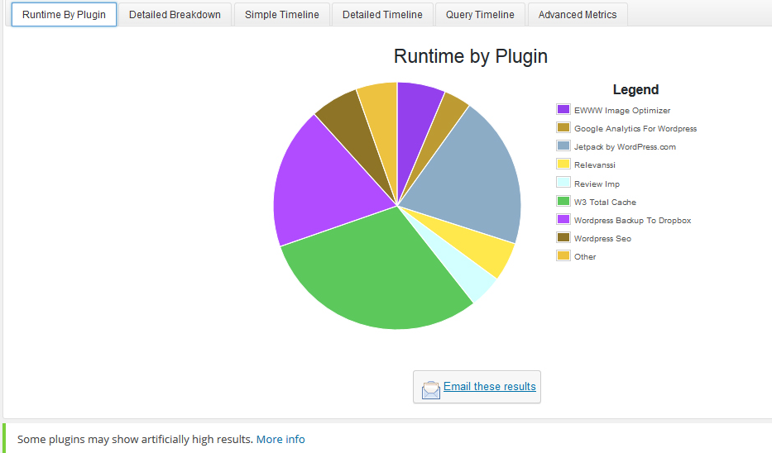
Notes:
Results look something like this, and you can hover over each segment to see more details like specific load time.

Slide 35
EWWW Image Optimizer
For us, cover images are often large files
Plugin compresses and optimises all image files
Lossless and lossy options available, depending on what you want

Slide 36
Plugins Mentioned
W3 Total Cache
P3 Plugin Profiler
EWWW Image Optimizer
Cloudflare
All have free versions/options!

Slide 37
Keeping Your Blog Secure
Ashley // Keep those hackers out!
Notes:
Ashley, backup by Cialina

Slide 38
Protect Your Online Home
Bad people try to do bad things
  Hack for fun
  Hack for profit
Protect your blog like you would your house/car
Notes:
Some people like to watch the world burn, others will hack you to put in their adverts, others will redirect your site to theirs to steal your traffic.
You lock your car and your house – your blog is no different.

Slide 39
Brute Forcing
Bots/scripts guess passwords over and over again
An ordinary computer can test between 100 million and BILLIONS of passwords per second
Most attempts try to login with the username “admin”
By treating your username like a password, you make it that much harder for hackers
Notes:
One of the most common ways people get hacked is through brute forcing
Brute forcing: a computer tries every possible combination until it gets the right password.
Sit on login page trying over and over again.
Strong username means hackers have to guess the username AND the password – not just one
Don’t use the username “admin”

Slide 40
What a strong password looks like
A combination of numbers, letters, and symbols.
Lengthy (over 14 characters)
NOT something commonly used
Random password generator
Entire sentences work well. Example:
  I’m a total lover of rainbow Skittles!
    Two symbols
    38 characters
    Easy to remember
    Upper and lower case
LastPass or 1Password to store your passwords

Slide 41
Protecting your WordPress blog
Preventative measures
  Strong password
  Secure username
  Brute force protection
  Plugin/theme/core updates
Prepare for the worst
  Take backups
  Know how to restore backups

Slide 42
Brute force protection
Limit Login Attempts (plugin)
  Limits the number of times someone can attempt to login
  Bans them after a certain number of failed tries
Htpasswd
  A password prompt that has to be filled out before accessing your normal WordPress login
Notes:
You need way to prevent users from sitting at your login page and trying passwords over and over again
If they somehow manage to brute force the htpasswd they still have to brute force your normal WP login.

Slide 43
ALWAYS update your site!
Updates aren’t just adding new features, they’re there to fix problems
Not all those problems are things you would notice – some of them are vulnerabilities with the code that hackers could exploit!
Massive plugin/core vulnerabilities in April/May alone.
  XSS vulnerability in April affected popular plugins: Jetpack, WordPress SEO, Gravity Forms, Ninja Forms, Broken Link Checker, WPTouch, and more.
Notes:
Some people don’t do updates because they’re afraid their plugin/theme will break.
People say “if it ain’t broke, don’t fix it! I don’t do my updates because it works fine as is.” Well there are coding things behind the scenes that might be patched!
Stats
Worst case scenario, the plugin will no longer work or it will cause you site to go down until you remove the plugin
It’s better to have a plugin that no longer works than a hacked site.

Slide 44
Backups
If your site gets hacked and you don’t have a backup, everything is gone.
Do not rely on your host to do it for you, even if they say they do.
A backup isn’t much use if you don’t know how to restore it.
Two methods:
  The easy, less-thorough method that is super easy for you to restore from.
  The harder, more-thorough, better method that’s more difficult to restore from.

Slide 45
Easy Mode: WordPress Export
Tools
  > Export
Notes:
Exports posts, pages, comments, menus
Images will NOT be restorable if your images are deleted

Slide 46
Easy Mode: WordPress Import
Tools
  > Import
    > WordPress

Slide 47
Easy Mode: Down Sides
Images will not be restored if they get deleted by the hacker
Does not back up plugins/themes
Does not back up settings

Slide 48
Other Backup Methods & Plugins
Plugins:
  WP to Dropbox
  BackUpBuddy
Automated, scheduled backups.
Two parts:
  Database
  Files
Don’t just assume they’re working, check them.
Notes:
Database: posts, comments, pages, settings.
Files: images, plugins, themes.

Slide 49
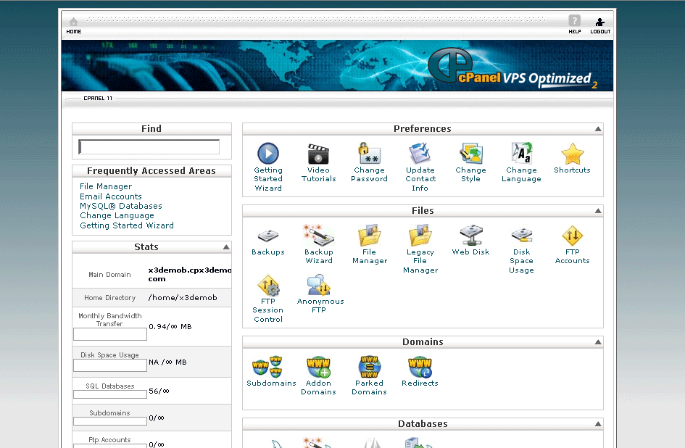
Harder Mode: cPanel Backup
cPanel is a popular control panel used
by many web hosts.
Two-step method:
  Backup database
  Backup files
Notes:
Cialina

Slide 50
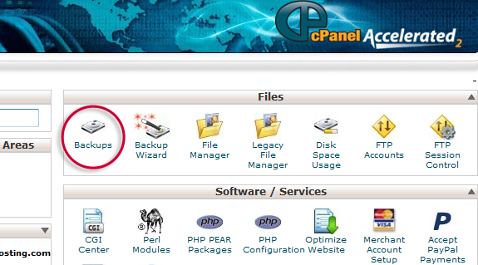
cPanel Backup: Database
Notes:
Cialina

Slide 51
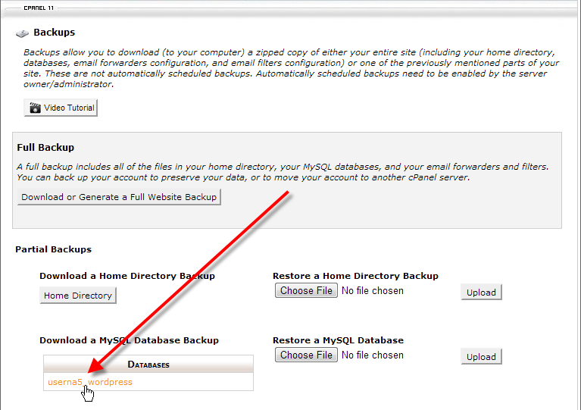
cPanel Back-up: Database
Notes:
Everyone’s database is going to be named differently.
If you have multiple databases on your server, and you don’t know which is the right one:
Download wp_config.php file through FTP and open it up in a text editor. It will list what database your Wordpress is using.
Personally, I like to keep three to five of my most recent database back-ups just in case. I also like to add the date to the filename to help me stay organized.

Slide 52
cPanel Backup: Files
Backup your images, plugins, themes!
Using your FTP client, download the entire wp_content folder
Download time varies depending on site
Notes:
Cialina

Slide 53
How Often Should I Back Up?
How many blog posts are you willing to lose?
The more active your blog is, the more often you should back up.
Stick to the back-up method you are most comfortable with if it means backing up more often!
Notes:
Cialina

Slide 54
Keeping Your Blog Organized
Cialina // Be the boss of your blog!
Notes:
Cialina

Slide 55
Blog Templates
Make your life easier with a preformatted template
Save time and also make your blog posts uniform throughout your blog!
Example: Easy Content Templates
Notes:
Blogging is already difficult. Sometimes it can be a struggle to get myself to write a post. But I find that the most tedious part of blogging is formatting my blog post.
If you don’t use one already, there are a ton of plugins that will make your life easier by setting up a preformatted template. It’s a great way to save time, but also make sure that your posts look uniform throughout your blog!
An example of this plugin is Easy Content Templates.

Slide 56
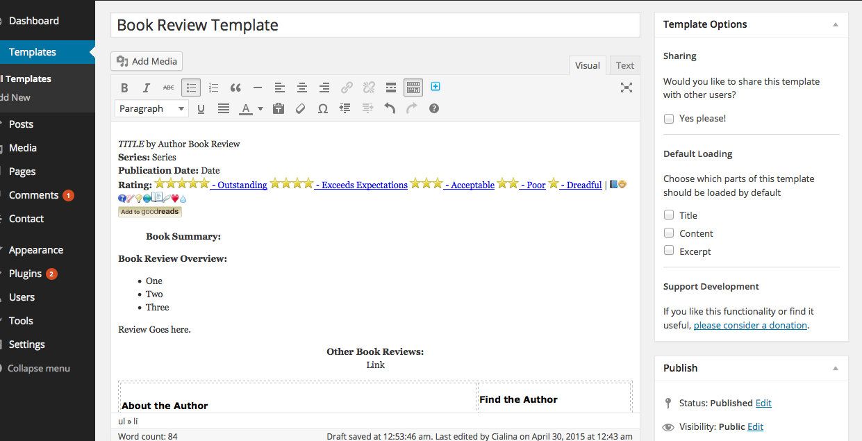
Easy Content Templates
Notes:
Setting up the template is as easy as writing a blog post.
This is how my template looks like.

Slide 57
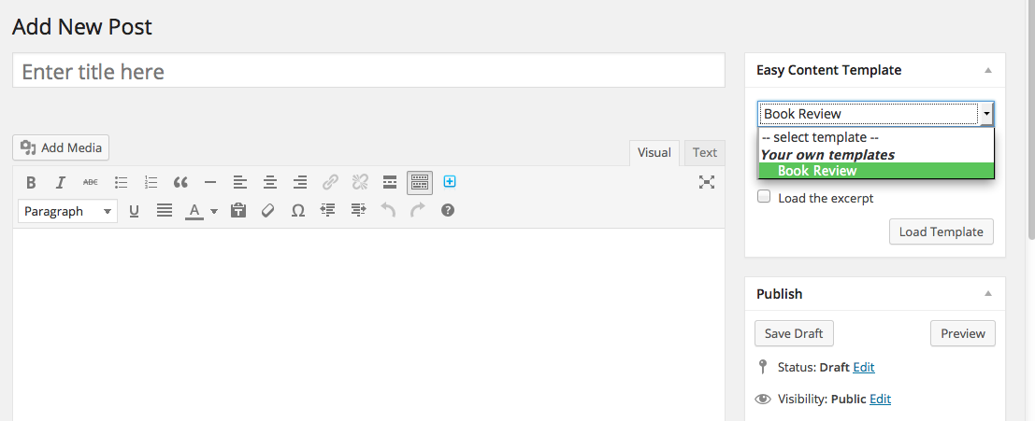
Easy Content Templates
Notes:
Add your template when you create a new blog post.

Slide 58
Blog Calendars
Another way to stay organized
Keep track of all your upcoming blog posts
Examples: Editorial Calendar and CoSchedule

Slide 59
Editorial Calendar vs. CoSchedule
 | Editorial Calendar | CoSchedule
Pros | Drag and drop calendar Supports multiple users Free plugin | Drag and drop calendar Social media integration: create and schedule social media posts in the same interface and boost traffic from older posts Supports multiple users
Cons | Not connected to social media | Premium Wordpress Plugin (currently $9/month)
Notes:
Editorial Calendar and CoSchedule are very similar in their functions. Both are drag and drop calendars that will allow you to see your scheduled posts in a calendar format. The biggest difference is that CoSchedule has social media integration. They allow you to create social media content at the same time that you are writing your blog posts.
However, CoSchedule is a premium plugin that costs $9 per month for up to five users - so it is probably more ideal for blogs with multiple authors that publish posts on a regular basis.

Slide 60
Questions?

